Slide 1

SALES DASHBOARD FOR WALMART
Nithyashree Vaidyanath (50360927)
Navya Sravanthi Undavalli (50340856)
Sameen Siddiqua(50338823)
Amuktha Kundaravalli(50340856)

Slide 2
DATA SET
Data was collected from previous Walmart sales for year 2021 and 2022
The data contains sales transactions that include product details, quantities sold, selling and buying prices, as well as the mode and type of sale. It’s structured across two sheets:
Input Data: Contains transaction-level details like date, product ID, quantity, sale type (e.g., direct sales, online, wholesaler), payment mode (e.g., cash, online), and discount percentages.
Master Data: Provides additional information on products, including category, unit of measure, buying price, and selling price.

Slide 3
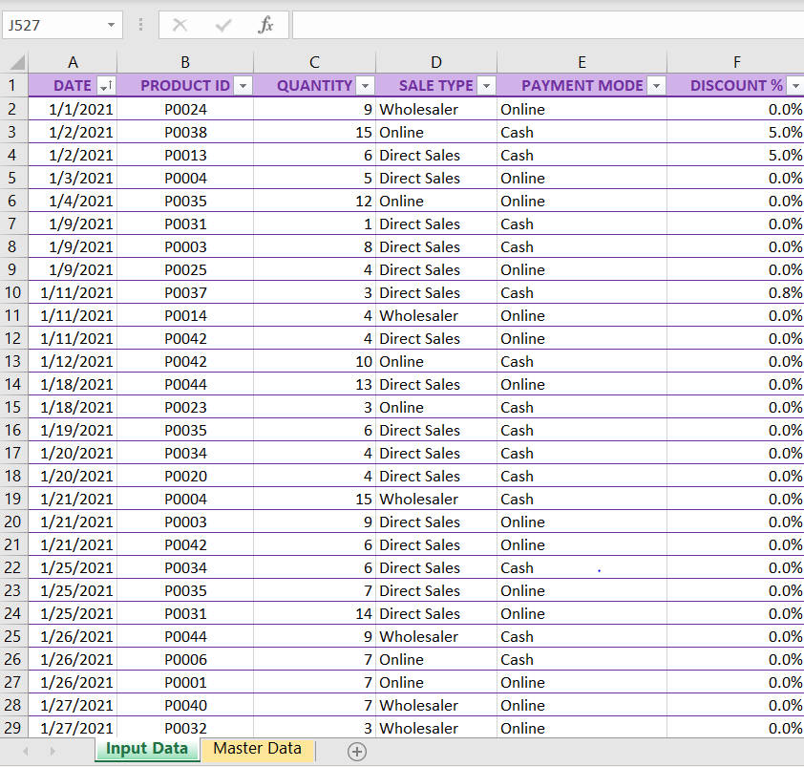
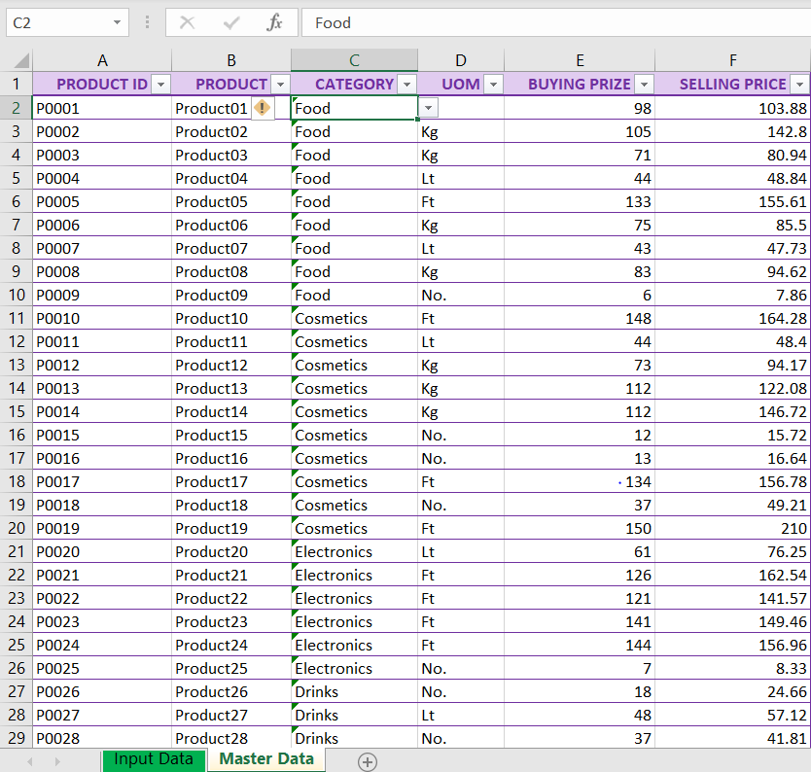
DATA SET

Slide 4
KEY PERFORMANCE INDICATORS
Total Sales: Represents the sum of selling values from all transactions. It indicates overall revenue generated.
Total Quantity Sold: Shows the total number of units sold across all products, reflecting sales volume.
Total Profit: Calculated as the difference between total selling value and total buying value. It measures overall profitability.
Average Profit Percentage : Average margin on sales, showing the efficiency of pricing and cost management.
Top Categories by Sales: Highlights the leading categories contributing to total sales:
Payment Mode Distribution on sales :Shows the preference for payment methods among customers(Online or Offline).
Sales Type Distribution: Helps identify the dominant sales channels and adjust strategies accordingly(Direct Sales , Online or Wholesaler).

Slide 5
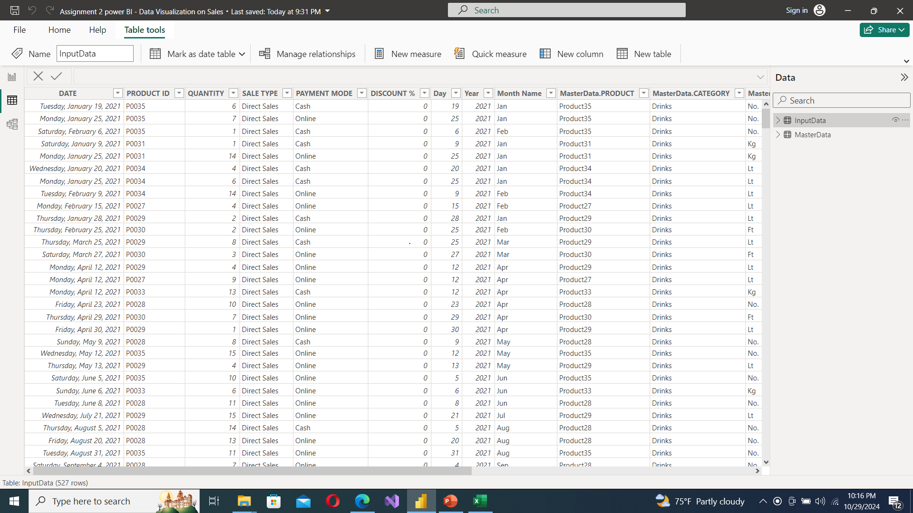
DATA IMPORT AND PREPARATION
Import data into Power BI and edit in Power Query Editor.
Check for missing values

Slide 6
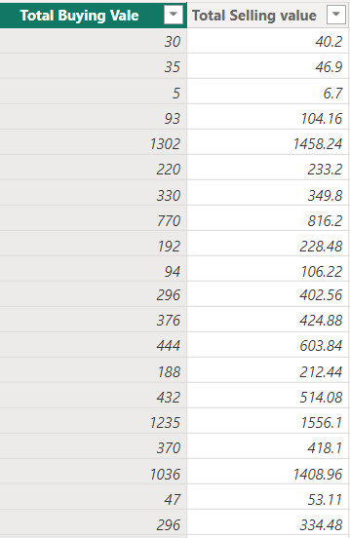
CREATE NEW COLUMNS AND MEASURES
Add columns for day, month, year derived from column DATE from Input Data
Create New columns for Total Buying Value and Total Selling Value
Total Buying Vale = 'InputData'[QUANTITY]*'InputData'[MasterData.BUYING PRIZE]
Total Selling value = 'InputData'[QUANTITY]*InputData[MasterData.SELLING PRICE]*(1-InputData[DISCOUNT %])

Slide 7
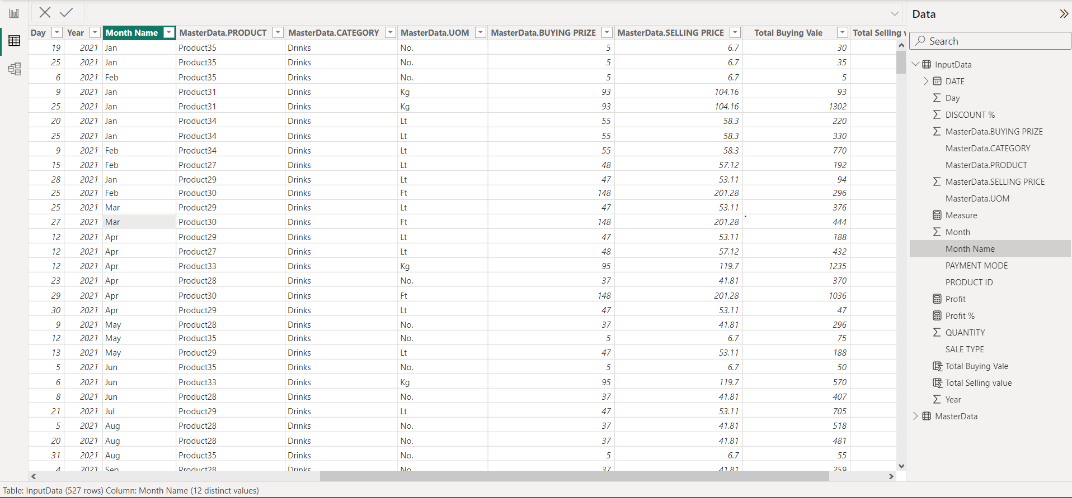
ADDING FACT MEASURES
Create measures for profit and profit percentage.
Profit = SUM(InputData[Total Selling value])-SUM(InputData[Total Buying Vale])
Profit % = [Profit]/SUM(InputData[Total Buying Vale])
Merge Master Data and Input data through Product ID through full outer join.

Slide 8
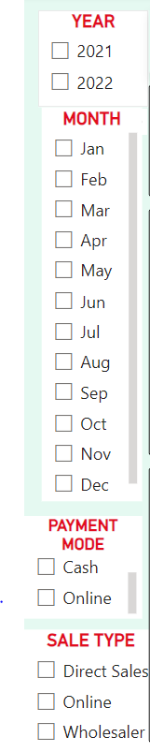
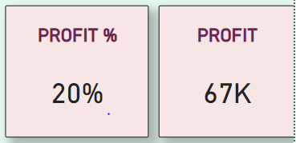
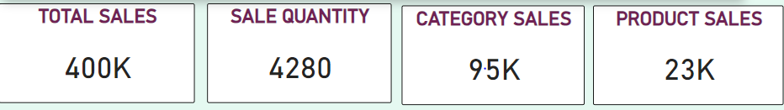
BUILDING VISUALIZATIONS
Slicers for year, month, sales type, and payment mode.
Adding card visuals for total sales, profit, and top products/categories.
Using a suitable charts chart to represent monthly sales.

Slide 9
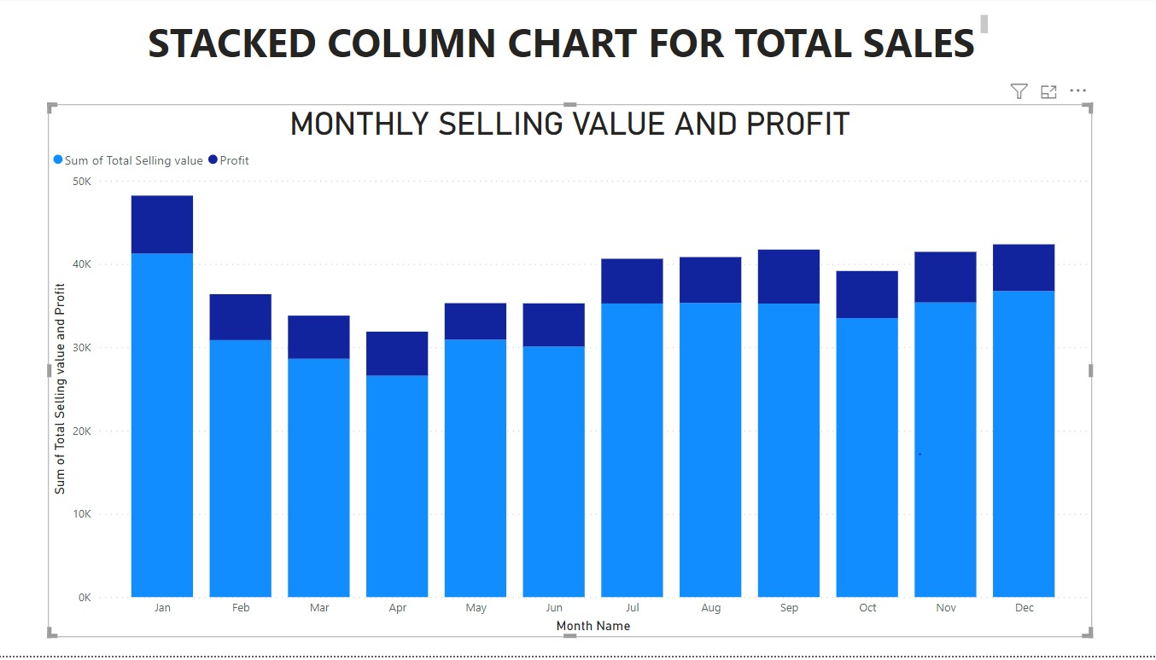
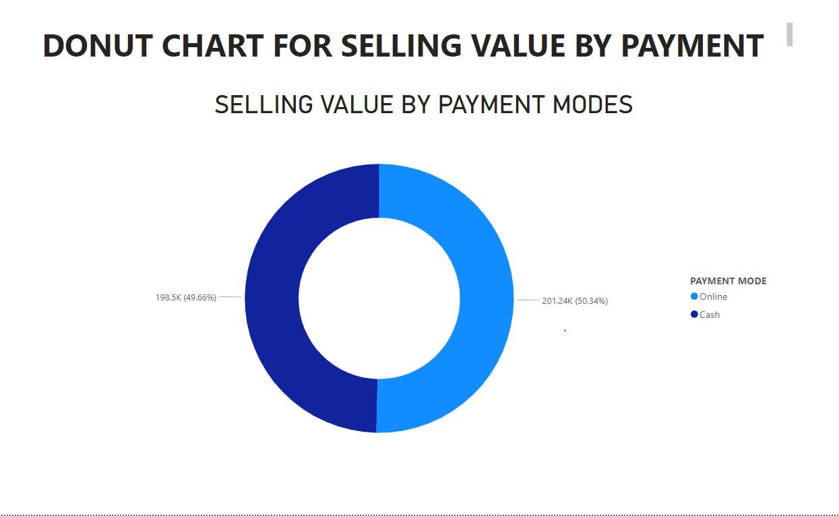
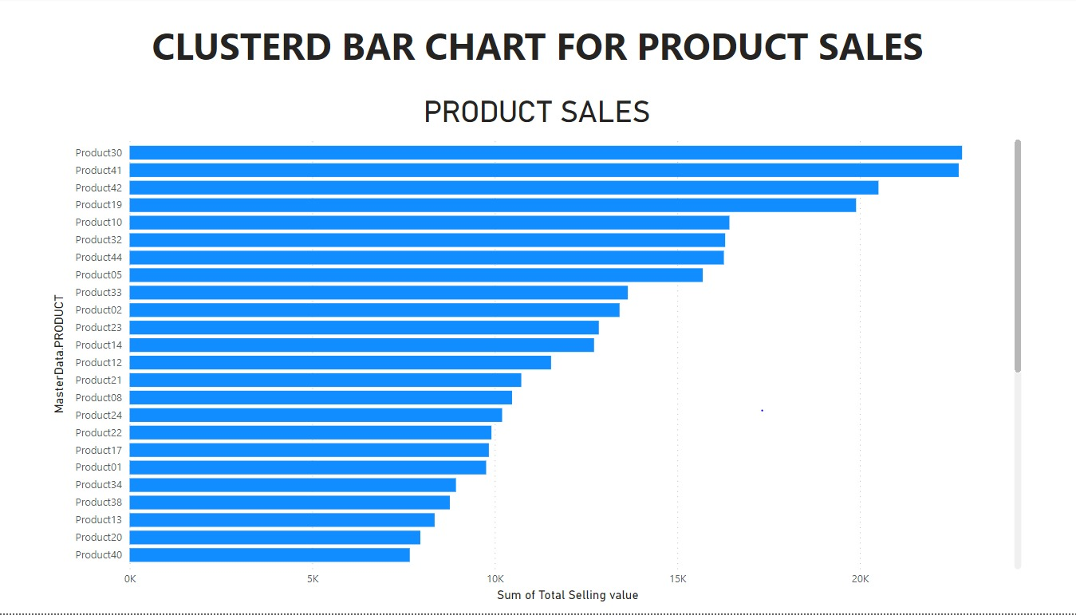
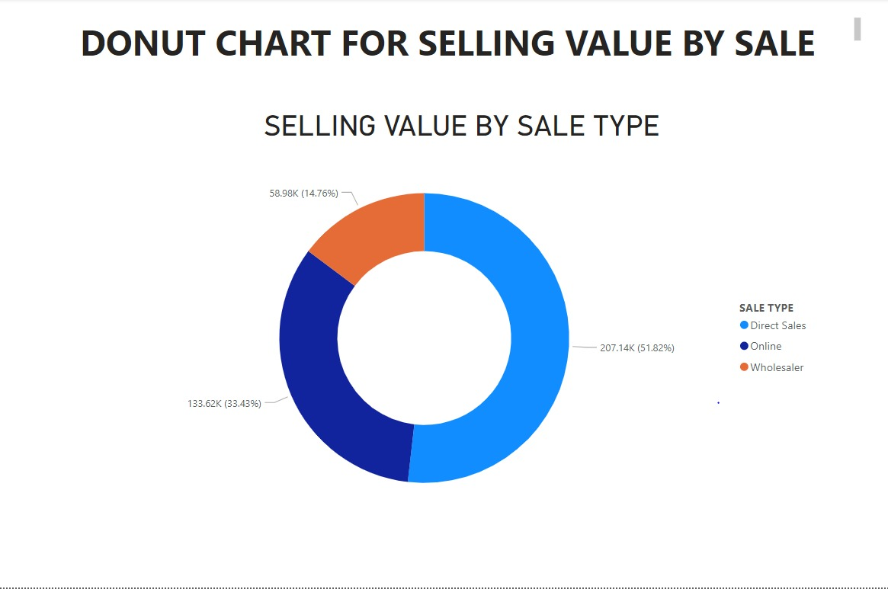

Slide 10
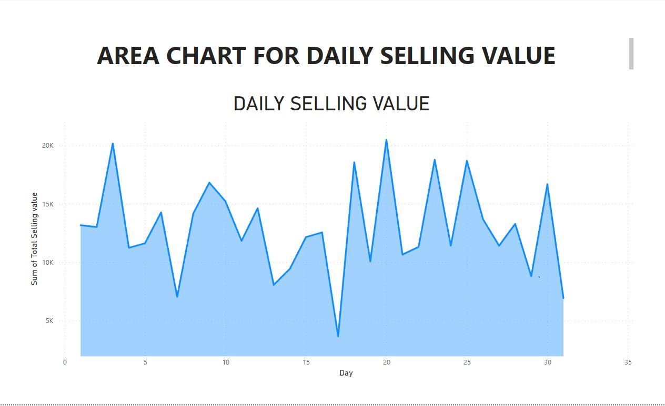
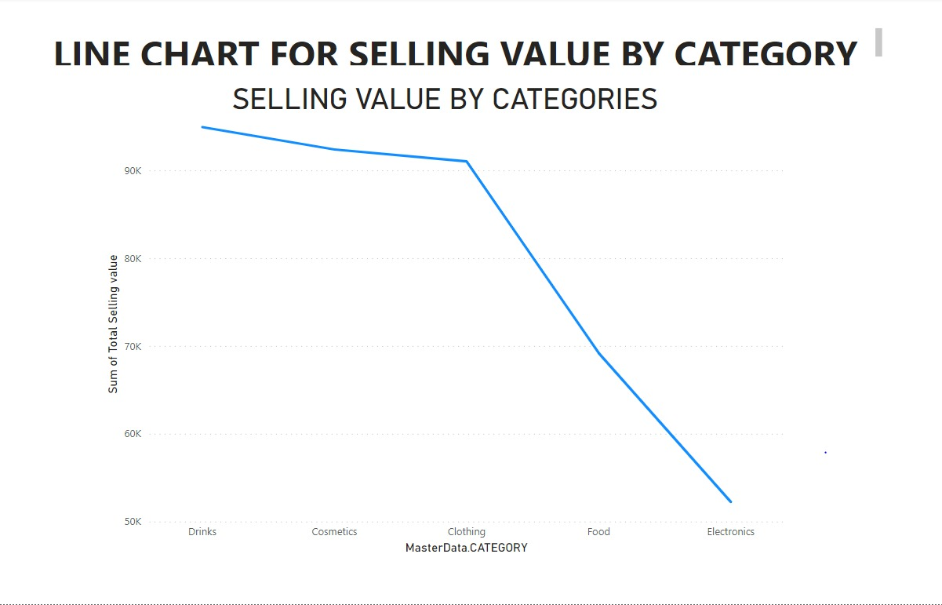
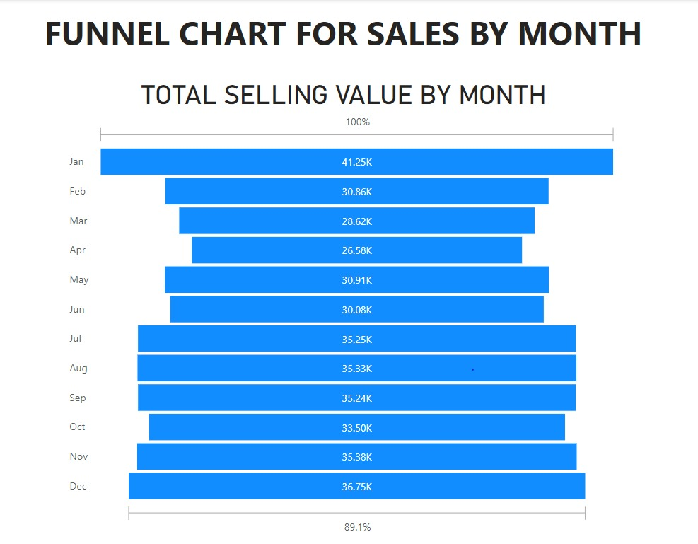
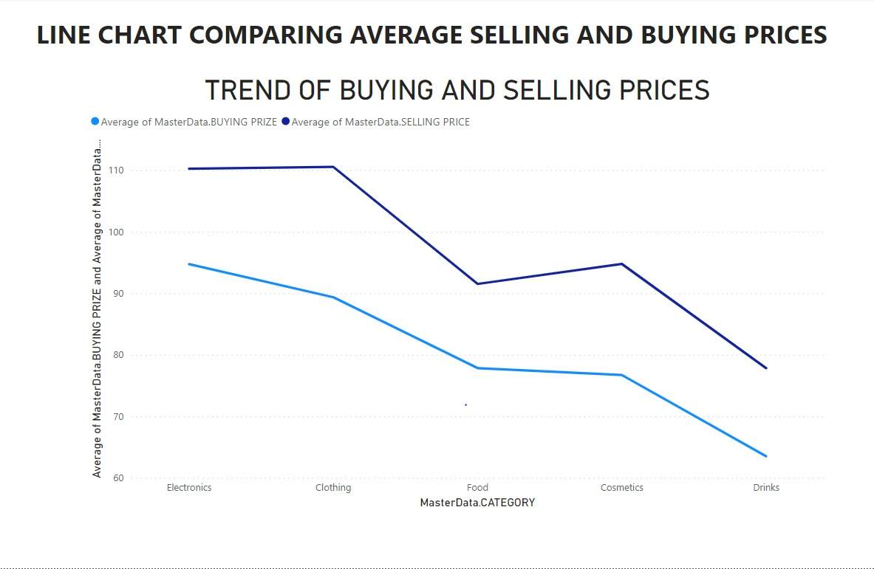

Slide 11
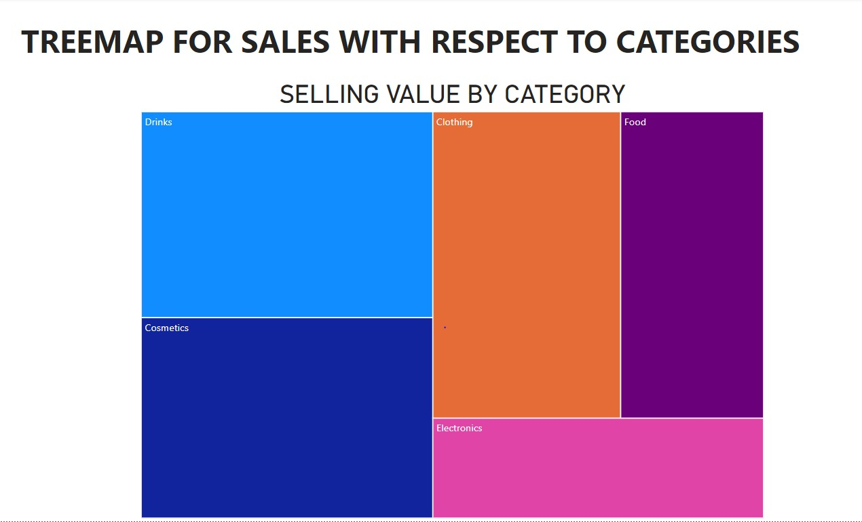
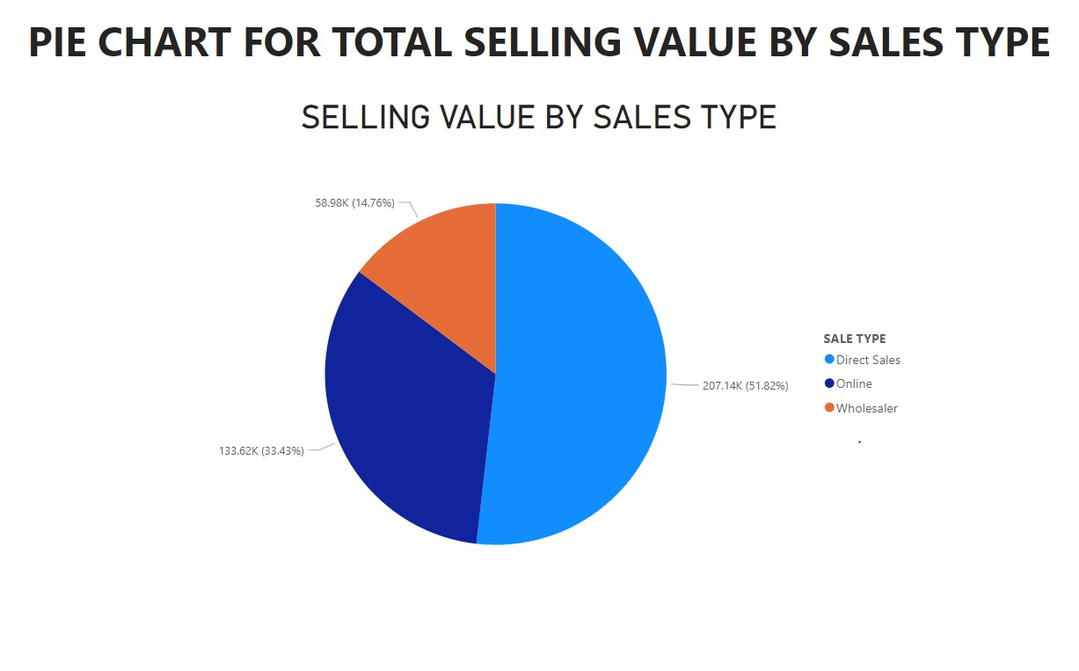

Slide 12
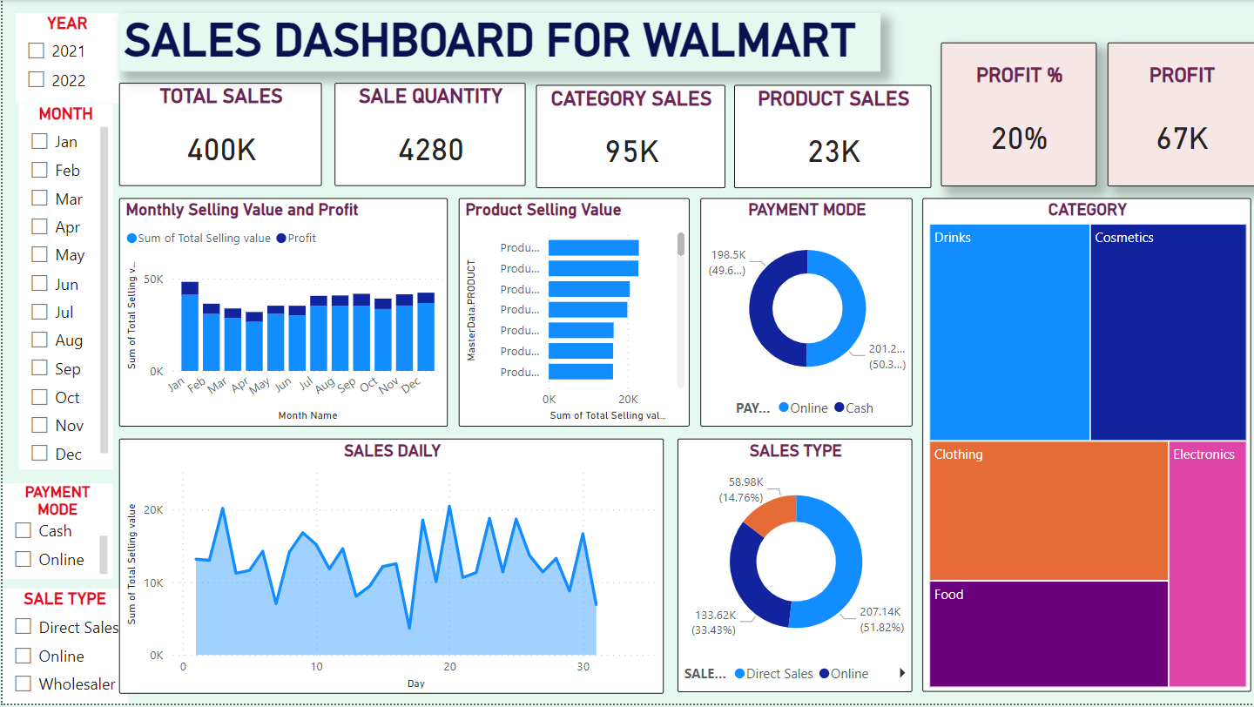
DASHBOARD

Slide 13
INSIGHTS
Total sales of $400K and a total profit of $67K, the business demonstrates solid revenue generation and profitability.
The average profit margin is 20%, showing effective cost management
The top categories driving sales are Drinks, Cosmetics, and Clothing
This insight suggests a strong consumer demand for these categories, and efforts to expand product lines or marketing in these segments could enhance sales further.
Payment methods are almost evenly split, with cash at 50.1% and online at 49.9%.
Direct sales lead at 53.7%, followed by online sales at 31.7%.

Slide 14
CONCLUSION
The analysis of the Walmart sales dashboard reveals that the business has been successful in generating consistent revenue and profit, with strong customer demand in key product categories.
To further enhance performance, the business could focus on Promoting high-demand categories like Drinks and Cosmetics through targeted marketing campaigns.
Leveraging online channels to increase the share of digital sales.
Optimizing payment processesto encourage more online transactions.
Overall, the business is positioned well, with growth opportunities in both online sales and specific product categories. The focus should be on capitalizing on these insights to drive future growth and profitability.

Slide 15
THANK YOU

